Slide 1
PySpark & AWS: Master Big Data With PySpark and AWS
Hands on Big Data course including in demand industry skills

Slide 2
BIG DATA

Slide 3
Prerequisites

Slide 4
Applications of Spark

Slide 5
Applications of Spark
Streaming Data

Slide 6
Applications of Spark
Streaming Data
Machine Learning

Slide 7
Applications of Spark
Streaming Data
Machine Learning
Batch Data

Slide 8
Applications of Spark
Streaming Data
Machine Learning
Batch Data
ETL Pipelines

Slide 9
Applications of Spark
Streaming Data
Machine Learning
Batch Data
ETL Pipelines
Full load and Replication on going

Slide 10
What’s Inside?

Slide 11
Methodology

Slide 12
Projects

Slide 13
Student Data Analysis

Slide 14
Employee Data Analysis

Slide 15
Collaborative Filtering

Slide 16
Spark Streaming

Slide 17
ETL Pipeline

Slide 18
Full Load and Replication on Going

Slide 19
Spark

Slide 20
Why Spark?
Speed
Distributed
Advanced Analytics
Real Time
Powerful Caching
Fault Tolerant
Deployment

Slide 21
HADOOP

Slide 22
HADOOP
Map Reduce
SPARK
YARN
HDFS

Slide 23
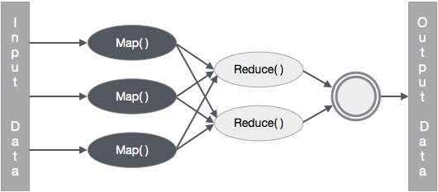

Slide 24
Spark Architecture

Slide 25
Spark Architecture
Workers
Driver Node
Spark Context
Cluster Manager
Workers

Slide 26
Spark Ecosystem

Slide 27
Spark Ecosystem
SPARK SQL
SPARK STREAMING
SPARK MLlib
SPARK GRAPHX
SPARK CORE API
JAVA
SCALA
PYTHON
R

Slide 28
DataBricks

Slide 29
Spark Local Setup

Slide 30
Spark RDDs

Slide 31
Spark RDDs
RDD is the spark’s core abstraction which stands for Resilient Distributed Dataset
RDD is the immutable distributed collection of objects
Internally spark distributes the data in RDD, to different nodes across the cluster to achieve parallelization.

Slide 32
Transformations and Actions

Slide 33
Transformations and Actions
Transformations create a new RDD from an existing one.
Actions return a value to the driver program after running a computation on the RDD
All transformations in Spark are lazy
Spark only triggers the data flow when there’s a action

Slide 34
Creating Spark RDD

Slide 35
Running Code Locally

Slide 36
map()
Map is used as a maper of data from one state to other
It will create a new RDD
rdd.map(lambda x: x.split())

Slide 37
QUIZ

Slide 38
QUIZ
For the quiz you’ll be using this input file
Hi how are you?
Hope you are doing
great
Read this file in the RDD
Write a mapper that will provide the length of each word in the following format
[ [2, 3, 3, 4], [4, 3, 3, 5], [5] ]

Slide 39
QUIZ SOLUTION

Slide 40
flatMap()
Flat Map is used as a maper of data and explodes data before final output
It will create a new RDD
rdd.flatMap(lambda x: x.split())

Slide 41
filter()
Filter is used to remove the elements from the RDD
It will create a new RDD
rdd.filter(lambda x: x != 123)

Slide 42
QUIZ

Slide 43
QUIZ
For the quiz you’ll be using this input file
this mango company animal
cat dog ant mic laptop
chair switch mobile am charger cover
amanda any alarm ant
Read this file in the RDD
Write a filter that will remove all the words that are either starting from a or c from the rdd

Slide 44
QUIZ SOLUTION

Slide 45
distinct()
Distinct is used to get the distinct elements in RDD
It will create a new RDD
rdd.distinct()

Slide 46
groupByKey()
GroupByKey is used to create groups based on Keys in RDD
For groupByKey to work properly the data must be in the format of (k,v), (k,v), (k2,v), (k2,v2)
  Example: (“Apple”,1), (“Ball”,1), (“Apple”,1)
It will create a new RDD
rdd.groupByKey()
mapValues(list) are usually used to get the group data

Slide 47
reduceByKey()
ReduceByKey is used to combined data based on Keys in RDD
For reduceByKey to work properly the data must be in the format of (k,v), (k,v), (k2,v), (k2,v2)
  Example: (“Apple”,1), (“Ball”,1), (“Apple”,1)
It will create a new RDD
rdd.reduceByKey(lambda x, y: x + y)

Slide 48
QUIZ

Slide 49
QUIZ
For the quiz you’ll be using this input file
this mango company
cat mango ant animal laptop
chair switch mango am charger cover
animalany mango ant laptop laptop
this
Read this file in the RDD
Write a transformation flow that will return the word count of each word present in the file as (key, value) pair

Slide 50
QUIZ SOLUTION

Slide 51
count()
count returns the number of elements in RDD
count is an action
rdd.count()

Slide 52
countByValue()
CountByValue provide how many times each value occur in RDD
countByValue is an action
rdd.countByValue()

Slide 53
saveAsTextFile()
SaveAsTextFile is used to save the RDD in the file
saveAsTextFile is an action
rdd.saveAsTextFile(‘path/to/file/filename.txt’)

Slide 54
RDDs Functions

Slide 55
repartition()
Repartition is used to change the number of partitions in RDD
It will create a new RDD
rdd.repartition(number_of_partitions)

Slide 56
coalesce()
Coalesce is used to decrease the number of partitions in RDD
It will create a new RDD
rdd.coalesce(number_of_partitions)
coalesce is only used to decrease the number of partition

Slide 57
Finding Average

Slide 58
QUIZ

Slide 59
QUIZ
For the quiz you’ll be using this input file
JAN,NY,3.0
JAN,PA,1.0
JAN,NJ,2.0
JAN,CT,4.0
FEB,PA,1.0
Read this file in the RDD
Write a code to calculate the average score in each month

Slide 60
QUIZ SOLUTION

Slide 61
Finding Min and Max

Slide 62
QUIZ

Slide 63
QUIZ
For the quiz you’ll be using this input file
JAN,NY,3.0
JAN,PA,1.0
JAN,NJ,2.0
JAN,CT,4.0
FEB,PA,1.0
Read this file in the RDD
Write a code to calculate the Minimum and Maximum rating given by each city.

Slide 64
QUIZ SOLUTION

Slide 65
Mini Project

Slide 66
Mini Project
For the project you’ll be using this input file StudentData.csv that has following columns
age,gender,name,course,roll,marks,email
Read this file in the RDD

Slide 67
Mini Project

Slide 68
Mini Project
Perform the following analytics on the data
  Show the number of students in the file.
  Show the total marks achieved by Female and Male students
  Show the total number of students that have passed and failed. 50+ marks are required to pass the course.
  Show the total number of students enrolled per course
  Show the total marks that students have achieved per course
  Show the average marks that students have achieved per course
  Show the minimum and maximum marks achieved per course
  Show the average age of male and female students

Slide 69
Spark DataFrames

Slide 70
DataFrame
DataFrame is a wrapper on the RDD
A DataFrame is a Dataset organized into named columns
It is conceptually equivalent to a table in a relational database or a data frame in R/Python
DataFrames can be constructed from a wide array of sources such as
  Structured data files
  Unstructured data files
  External databases
  Existing RDDs

Slide 71
Creating Dataframe

Slide 72
Schema of Dataframe

Slide 73
Providing Schema of Dataframe

Slide 74
Creating DataFrame from RDD

Slide 75
Select DataFrame Columns

Slide 76
withColumn in DataFrame

Slide 77
withColumnRenamed in DataFrame

Slide 78
filter/where in DataFrame

Slide 79
QUIZ

Slide 80
QUIZ
For the quiz you’ll be using StudentData.csv
Read this file in the DF
Create a new column in the DF for total marks and let the total marks be 120
Create a new column average to calculate the average marks of the student.
  (marks / total marks) * 100
Filter out all those students who have achieved more than 80% marks in OOP course and save it in a new DF.
Filter out all those students who have achieved more than 60% marks in Cloud course and save it in a new DF.
Print the names and marks of all the students from the above DFs

Slide 81
QUIZ SOLUTION

Slide 82
Count, Distinct, DropDuplicates
in DataFrame

Slide 83
QUIZ

Slide 84
QUIZ
For the quiz you’ll be using StudentData.csv
Read this file in the DF
Write a code to display all the unique rows for age, gender and course column.

Slide 85
QUIZ SOLUTION

Slide 86
sort/orderBy in DataFrame

Slide 87
QUIZ

Slide 88
QUIZ
For the quiz you’ll be using OfficeData.csv
Read this file in the DF
Create a DF, sorted on bonus in ascending order and show it.
Create a DF, sorted on age and salary in descending and ascending order respectively and show it.
Create a DF sorted on age, bonus and salary in descending, descending and ascending order respectively and show it

Slide 89
QUIZ SOLUTION

Slide 90
groupBy in DataFrame

Slide 91
QUIZ

Slide 92
QUIZ
For the quiz you’ll be using StudentData.csv
Read this file in the DF
Display the total numbers of students enrolled in each course
Display the total number of male and female students enrolled in each course
Display the total marks achieved by each gender in each course
Display the minimum, maximum and average marks achieved in each course by each age group.

Slide 93
QUIZ SOLUTION

Slide 94
QUIZ

Slide 95
QUIZ
For the quiz you’ll be using WordData.txt
Read this file in the DF
Calculate and show the count of each word present in the file

Slide 96
QUIZ SOLUTION

Slide 97
UDFs in DataFrame

Slide 98
QUIZ

Slide 99
QUIZ
For the quiz you’ll be using OfficeData.csv
Read this file in the DF
Create a new column increment and provide the increment to the employees on the following criteria
  If the employee is in NY state, his increment would be 10% of salary plus 5% of bonus
  If the employee is in CA state, his increment would be 12% of salary plus 3% of bonus

Slide 100
QUIZ SOLUTION

Slide 101
Cache and Persist

Slide 102
Cache and Persist
TRANSFORMATION 1
TRANSFORMATION 2
ACTION 1
ACTION 2
TRANSFORMATION 1
TRANSFORMATION 2
CACHE()
ACTION 1
ACTION 2

Slide 103
DF to RDD

Slide 104
Spark SQL

Slide 105
Writing DataFrame

Slide 106
Mini Project

Slide 107
Mini Project
For the project we’ll be using OfficeDataProject.csv
Read data from the file in the DF and perform following analytics on it.
  Print the total number of employees in the company
  Print the total number of departments in the company
  Print the department names of the company
  Print the total number of employees in each department
  Print the total number of employees in each state
  Print the total number of employees in each state in each department
  Print the minimum and maximum salaries in each department and sort salaries in ascending order
  Print the names of employees working in NY state under Finance department whose bonuses are greater than the average bonuses of employees in NY state
  Raise the salaries $500 of all employees whose age is greater than 45
  Create DF of all those employees whose age is greater than 45 and save them in a file

Slide 108
Collaborative filtering

Slide 109
Utility Matrix

Slide 110
Utility Matrix
 | Movie 1 | Movie 2 | Movie 3 | Movie 4
User 1 | 1 | 5 | 4 | N/A
User 2 | N/A | 3 | N/A | 4
User 3 | 2 | N/A | N/A | 4
User 4 | 4 | 4 | 2 | 5

Slide 111
Explicit and Implicit Ratings

Slide 112
Expected Results

Slide 113
Expected Results
UserId | MovieId | Rating
1 | 1 | 4.8
1 | 22 | 5
2 | 12 | 4
2 | 11 | 3.9

Slide 114
Hands On

Slide 115
Dataset Overview

Slide 116
Joining DFs

Slide 117
Create Train and Test Data

Slide 118
ALS model

Slide 119
Hyperparameter tuning and cross validation

Slide 120
Best model and evaluate predictions

Slide 121
Recommendations

Slide 122
Spark Streaming

Slide 123
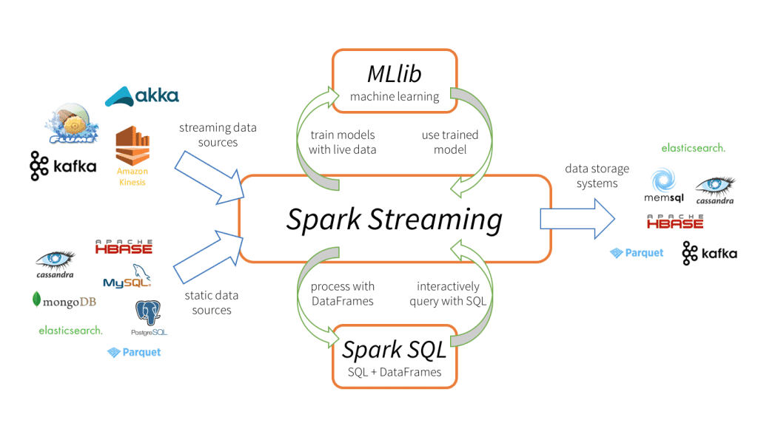

Slide 124
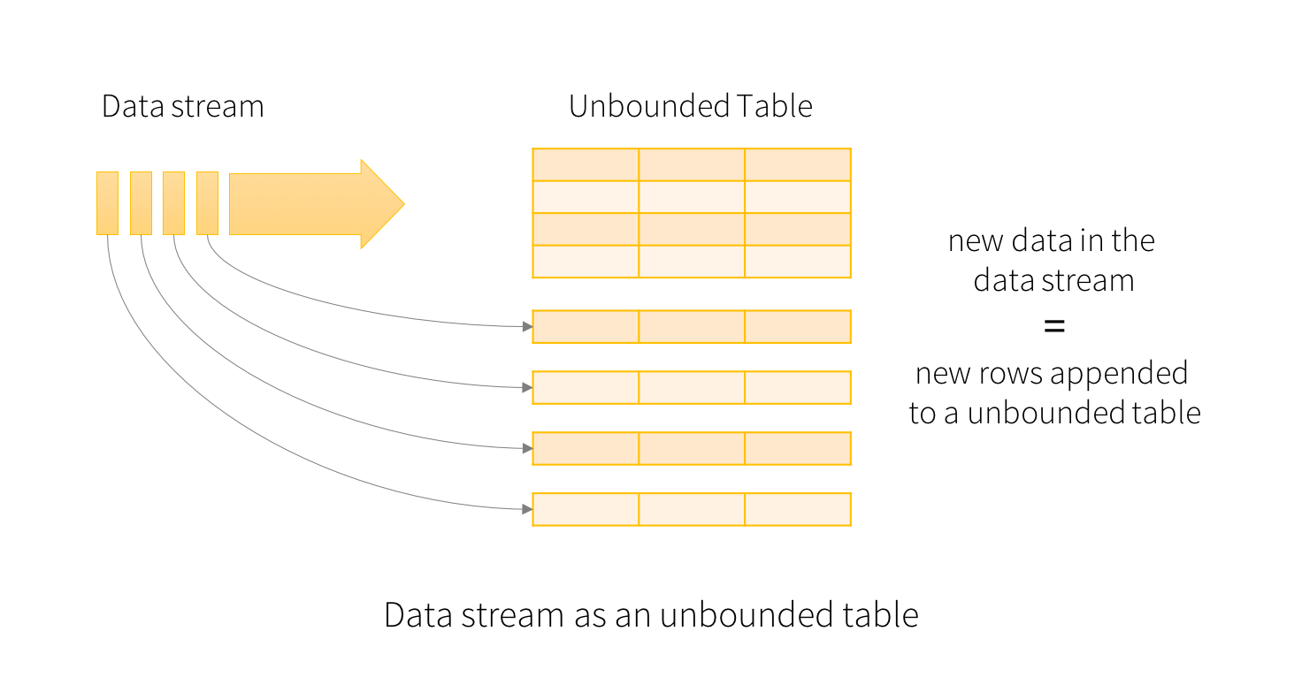

Slide 125
Spark Streaming With RDD

Slide 126
Spark Streaming With DF

Slide 127
ETL Pipeline

Slide 128

csv
Data Extraction
csv
txt
txt
ETL
jdbc
jdbc
…..
Data Load
…..

Slide 129
CSV in DBFS
PySpark on
DataBricks NoteBook
Postgres
Database in AWS RDS
EXT
LD
Transformation

Slide 130
Data Set

Slide 131
Extract

Slide 132
Transform

Slide 133
Installing Postgresql

Slide 134
Load

Slide 135
Project

Slide 136
CDC - Change Data Capture / Replication On Going

Slide 137
Project Architecture

Slide 138
Project Architecture
DMS
RDS -> MySql
Source Endpoint
Destination EndPoint
Temp
HDFS / S3
Lambda
Trigger
Invoke
READ
FINAL
HDFS / S3
READ
WRITE
Glue -> PySpark

